Slide 1
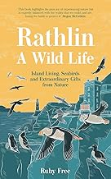
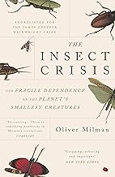
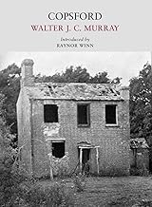
January 2025
Rathlin, A Wild Life – Ruby Free
In 2021, Ruby Free, 21, got her dream job working on an RSPB reserve. Heartfelt, impassioned and full of joy, Rathlin: A Wild Life is a love letter to the island and the wildlife Ruby finds there, but it’s also a call to action; a reminder of everything we stand to lose if we don’t change.
The Insect Crisis – Oliver Milman
The Insect Crisis explores this hidden emergency, arguing that its consequences could even rival climate change. We rely on insect pollination for the bulk of our agriculture, they are a prime food source for birds and fish, and they are a key strut holding up life on Earth, especially our own.
February
Copsford – Walter JC Murray
Walter Murray was a young man tired of living in the city. Early in the 1920s, he persuaded a Sussex farmer to rent him a derelict cottage, which stood alone on a hill, with no running water or electricity. Murray's intense feeling for his place is evident on every page. It is, though, no simple story of a rural idyll.

Slide 2
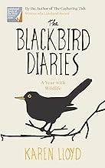
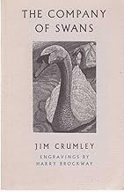
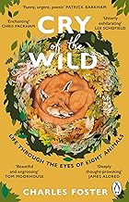
The Blackbird Diaries – Karen LLoyd
With its enchanting song, striking orange bill and endearing willingness to share our living space, the blackbird is one of our best-loved birds. And, in common with all our garden wildlife, it plays a critical role in Britain’s fragile and precious biodiversity. In The Blackbird Diaries, Karen Lloyd shares her deep-rooted knowledge and affection for the flora and fauna of these isles.
March
The Company of Swans - Jim Crumley
Crumley watches, year in and year out, as a pair of mute swans struggle. This beautiful record is Jim Crumley s homage to these noble creatures but it is also an elegy, a love song to one swan whose silent tragedy he watched from one season to the next, against the odds, to raise young on a wild patch of loch.
Cry of the Wild – Charles Foster
In spellbinding prose, Charles Foster gives us a bird’s eye view, or indeed an orca’s or an otter’s, of the wonders and struggles of the natural world. At once exhilarating and deeply moving, Cry of the Wild reconnects us with our animal side and brings us face to face, or whisker to whisker, with eight creatures (including humans) that we have pushed to the fringes, imploring us to change our ways.

Slide 3
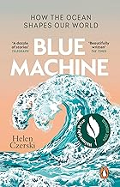
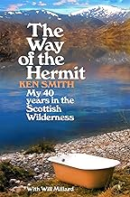
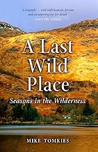
April
Blue Machine – Helen Czerski
Earth is home to a huge story that is rarely told - that of our ocean. Not the fish or the dolphins, but the massive ocean engine itself: what it does, why it works, and the many ways it has influenced animals, weather and human history & culture.
The Way of the Hermit – Ken Smith
Ken Smith has spent the past four decades in the Scottish Highlands. He lives alone, with no electricity or running water. His home is a log cabin nestled near Loch Treig, known as 'the lonely loch', where he lives off the land: he fishes for his supper, chops his own wood, and even brews his own tipple. He is, in the truest sense of the word, a hermit.
May
The Last Wild Place – Mike Tomkies
When he moved to a remote cottage on the shores of Loch Shiel in the West Highlands of Scotland, he found a place which was to provide him with the most profound wilderness experience of his life. Accessible only by boat, the cottage was to be his home for many years.

Slide 4
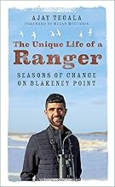
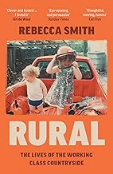
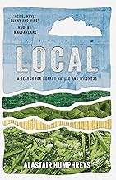
The Unique Life of a Ranger
Ajay Tegala
Few people have had the privilege of living on an isolated nature reserve of international importance, their every move judged by countless critics. Young ranger Ajay Tegala, embarking on his placement at Blakeney Point aged just nineteen, would have to stand firm in the face of many challenges to protect the wildlife of one of Britain's prime nature sites.
June
Rural – Rebecca Smith
Work in the countryside ties you, soul and salary, to the land. But often those who labour in nature have the least control over what happens there. Why have our rural industries been replaced by tourism? Why can't people stay living in the places they grew up? In this beautifully observed book, Rebecca Smith traces the stories of workers, to paint a picture of the working class lives that often go overlooked.
Local - Alastair Humphreys
After years of challenging expeditions all over the world, adventurer Alastair Humphreys spends a year exploring the small map around his own home. Can this unassuming landscape, marked by the glow of city lights and the hum of busy roads, hold any surprises for the world traveller or satisfy his wanderlust? Could a single map provide a lifetime of exploration?.

Slide 5
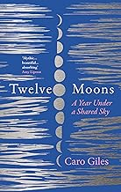
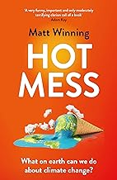
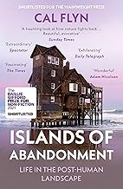
July
Twelve Moons – Caro Giles
Twelve Moons follows the lunar calendar, each chapter sharing a month and a moon, and shows the simmering power that lies in our often hidden daily lives. A dazzlingly honest memoir that while never turning away from the awkward truths of life, also shows how love will flourish if we can only find a space for ourselves.
Hot Mess – Matt Winning
We are currently facing a global climate emergency. You've probably noticed. But why does the end of the world need to be so depressing? Hot Mess aims to both lighten the mood and enlighten readers on climate change. This is a book for people who care about climate change but aren't doing much about it, helping readers understand what the main causes of climate change are, what changes are needed, and what they can (and can’t) do about it
August
Islands of Abandonment
Cal Flynn
This book explores the extraordinary places where humans no longer live – or survive in tiny, precarious numbers – to give us a possible glimpse of what happens when mankind’s impact on nature is forced to stop. Flynn brings together some of the most desolate, eerie, ravaged and polluted areas in the world – and shows how, against all odds, they offer our best opportunities for environmental recovery.

Slide 6
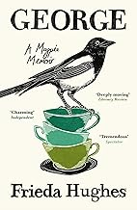
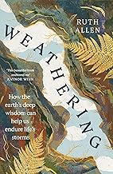
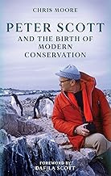
George – a Magpie Memoir
Frieda Hughes
When Frieda Hughes moved to the depths of the Welsh countryside, she was expecting to take on a few projects: planting a garden, painting and writing her poetry column for the Times. But instead, she found herself rescuing a baby magpie, the sole survivor of a nest destroyed in a storm - and embarking on an obsession that would change the course of her life
September
Weathering – Ruth Allen
Rocks and mountains have withstood aeons of life on our planet - gradually eroding, shifting, solidifying, and weathering. We might spend a little less time on earth, but humans are also weathering: evolving and changing as we're transformed by the shifting climates of our lives and experiences. So, what might these ancient natural forms have to teach us about resilience and change?
Peter Scott and the birth of Modern Conservation – Chris Moore
This new biography charts his life, from the young boy who grew up in the shadow of the tragic death of his famous father to the co-founder of the World Wildlife Fund and a major international figure in wildlife conservation

Slide 7
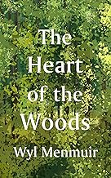
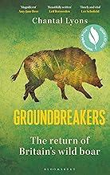
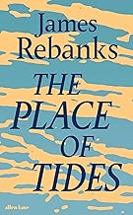
October
The Heart of the Wood – Wyl Menmuir
Throughout history, trees have determined the tools we use, the boats we build, the stories we tell about the world and ourselves, the songs we sing, and some of our most important rituals. As such, our lives are intertwined with those of the trees and woodlands around us.
Groundbreakers – Chantal Lyon
In Groundbreakers, Chantal Lyons moves to the boar's stronghold of the Forest of Dean to get up close and personal with this complex, intelligent and quirky species, and she meets with people across Britain and beyond who celebrate their presence - or want them gone.
November
The Place of Tides
James Rebanks
Many years ago, James Rebanks met an old woman on a remote Norwegian island. She lived and worked alone on a tiny rocky outcrop, caring for wild Eider ducks and gathering their down. Years later he asked to join her again and this is the account of the last season in a unique and ancient landscape which had a profound effect on him.

Slide 8
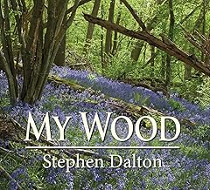
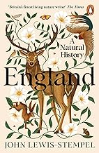
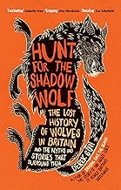
My Wood – Stephen Dalton
A well illustrated account of 4 seasons of a 9 acre wood in Sussex owned by the author which he has improved over the years increasing its biodiversity
December
England – John Lewis Stempel
In a stunning package, with specially commissioned illustrations and a map, England: A Natural History is the definitive volume on the English landscape and the capstone of John Lewis-Stempel's nature writing.
Hunt for the Shadow Wolf
Derek Gow
Hunt for the Shadow Wolf is Derek’s quest to uncover the true nature of this magnificent creature. As Derek worked to reintroduce the beaver, he began to hear stories of the wolf, both real and mythical, and his fascination with it grew. He pieced together fragments of information, stories and artefacts to reveal a shadowy creature that first walked proud through these lands and then was hunted to extinction.

