Slide 1
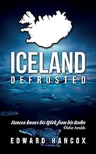
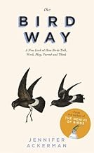
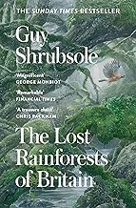
January
Iceland defrosted - Edward Hancox
This is the story of one Englishman’s obsession with a half-frozen, roughly duck-shaped island in the cold North Atlantic. Iceland, Defrosted is less about wars over cod, flight-halting volcanoes
and globe-shattering financiers, and more about relaxing
The Bird Way - Jennifer Ackerman
A Sunday Times Nature Book of the Year by an American ornithologist. Described as a ‘new look at how birds talk, work, parent and think’ ‘There is the mammal way and there is the bird way’. Perhaps complementary to Planta Sapiens?
February
The Lost Rainforests of Britain
Guy Shrubsole
Temperate rainforest may once have covered up to one-fifth of Britain, inspiring though only fragments now remain, they are home to a dazzling variety of luminous life-forms. In this awe-inspiring investigation, Travelling through the Western Highlands and the Lake District, down to the rainforests of Wales, Devon, and Cornwall to map these spectacular lost worlds for the first time.

Slide 2
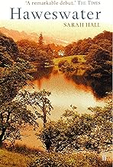
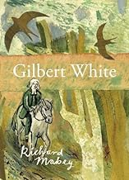
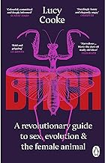
Haweswater - Sarah Hall (novel)
The story of the village that was flooded to create Haweswater reservoir (which we heard about last year in Wild Fell). Haweswater remembers a rural England that has been disappearing for decades. It is a novel about love, obsession and the destruction of a community, told with grace and artistry by a young storyteller of great imaginative and emotional power.
March
Gilbert White - Richard Mabey
New edition of the biography of Gilbert White (1720-1793) a pioneering naturalist whose Natural History of Selborne laid the ground for works of natural history for two hundred years and which has never been out of print. In this biography, Richard Mabey recreated a life and wonderfully evoked White's Hampshire landscape. He sets out his life and times and illuminates both his mistakes and discoveries
Bitch What it means to be female A revolutionary guide to sex, evolution and the female
Animal - Lucy Cooke
Written by a Master in Zoology from Oxford University who is now a broadcaster and film maker. It provides a wide survey of female behaviour throughout the natural world and discusses the implications for our modern understanding.

Slide 3
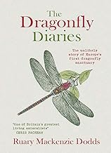
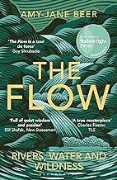
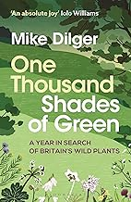
April
The Dragonfly Diaries - Ruary Mackenzie
The author shares his quirky fascination for these remarkable creatures over the 25 years he has been photographing and working with them. Combining fascinating description of the lives of dragonflies, with a diary chronicling the ups and downs of establishing Britain’s first public dragonfly sanctuary
The Flow River, Waters and Wildernesss
Amy-Jane Beer
The Flow is a book about water, and, like water, it meanders, cascades and percolates through many lives, landscapes and stories. From West Country torrents to Levels and Fens, rocky Welsh canyons, the salmon highways of Scotland and the chalk rivers of the Yorkshire Wolds, Amy-Jane follows springs, streams and rivers to explore tributary themes of wildness and wonder, loss and healing, mythology and history, cyclicity and transformation.
May
One Thousand Shades of Green
Mike Dilger
A nationwide quest to find 1,000 wild plant species in a single year. From Cornwall to Kent and Breckland to the Scottish Highlands, Mike meets the resilient reserve wardens and courageous conservationists tasked with protecting some of the nation's richest botanical sites, and experiences first-hand the many difficulties associated with saving our rarest and most charismatic plants.

Slide 4
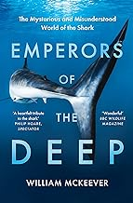
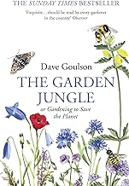
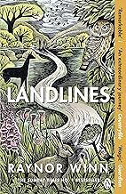
Emperors of the Deep The Mysterious and Misunderstood World of the Shark
William McKeever
Sharks are not as cuddly as whales and have therefore suffered from our instinctive fear of them, but they have their place in the ecosystem. McKeever researches their history and follows them to their breeding grounds.
June
The Garden Jungle: Gardening to save the Planet Dave Goulson
Introduction to the hundreds of small creatures such as insects, mice and shrews with whom we live cheek-by-jowl and of the myriad ways that we can encourage them to thrive. Takes us into the compost, under the lawn and into the garden pond and along the pavements.
Landlines - Raynor Winn.
The powerful story of a 1,000-mile healing walk—from the lochs of Scotland to England&#39;s
southwest coast. This is the 3 rd book by the author who travels with her husband on long distance
walks which help his health condition.

Slide 5
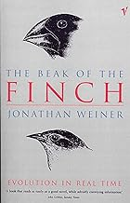
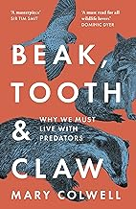
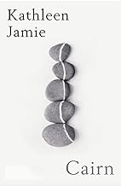
July
The Beak of the Finch - Jonathan Weiner
This is one of the easiest-to-read, most exciting books on evolution of the past twenty years. It
describes evolution happening before our eyes among the isolated bird populations of the
Galapagos - the very finches observed by Darwin on his Beagle voyage - and its heroes are an
unsung British couple.
Beak Tooth and Claw why we must live with predators - Mary Colwell
The curlew campaigner reflects on our contradictory attitudes to different predators in Britain and meets scientists and campaigners who are dealing with the issues presented by different mammals and raptors.
August
Cairn - Kathleen Jamie
Cairn: A marker on open land, a memorial, a viewpoint shared by strangers.
For the last five years poet and author Kathleen Jamie has been turning her attention to a new form of writing: micro-essays, prose poems, notes and fragments. Placed together, like the stones of a wayside cairn, they mark a changing psychic and physical landscape.

Slide 6
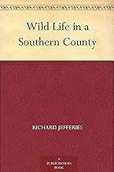
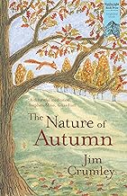
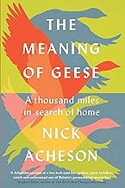
Wildlife in a Southern County - Richard Jefferies
First published in 1879 Jefferies is an important British nature writer with a book prize named after him who should probably be read more widely. This book traces the course of a stream rising in an Iron Age hillfort on the southern downs and describes its course through villages and hamlets to the water meadows and pond and the humans and wildlife he encounters.
September
The Nature of Autumn - Jim Crumley
A pilgrimage through the shapes and shades of autumn. In autumn nature stages some of its most enchantingly beautiful displays; yet it’s also a period for reflection – melancholy, even – as the days shorten and winter’s chill approaches. Charting the colourful progression from September through October & November,. Jim Crumley tells the story of how unfolding autumn affects the wildlife and landscapes of his beloved countryside. This completes the Season quartet for us.
The Meaning of Geese - Nick Acheson
During a time when many people faced the prospect of little work or human
contact, Nick followed the pinkfeet and brent geese that filled the Norfolk skies
and landscape as they flew in from Iceland and Siberia.

Slide 7
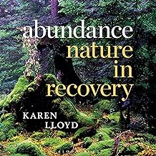
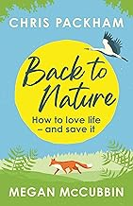
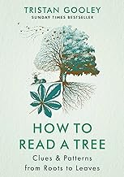
October
Abundance Nature in Recovery - Karen Lloyd
In this collection, Karen Lloyd explores abundance and loss in the natural world, relating compelling stories of restoration, renewal and repair, describing how those working on the front lines of conservation are challenging the inevitability of biodiversity loss, as well as navigating her own explorations of the meaning of abundance in the Anthropocene.
Back to Nature
Chris Packham and Megan McCubbin
From our balconies and gardens to our woodlands, national parks and beyond, Back
to Nature captures the essence of how we feel about the wildlife outside our windows. Through
personal stories, conservation breakthroughs and scientific discoveries, it explores the wonder and
the solace of nature, and the ways in which we can connect with it - and protect it.
November
How to Read a Tree - Tristan Gooley
Each tree we meet is filled with signs that reveal secrets about the life that tree and the landscape we stand in. The clues are easy to spot when you know what to look for but remain invisible to most people. In How to Read a Tree, you'll discover the simple principles that explain the shapes and patterns you can see in trees and what they mean. And you'll learn rare skills that can be applied every time you pass a tree, whether you are in a town or a wilder spot.

Slide 8
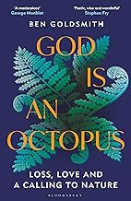
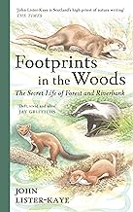
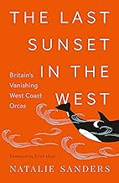
God is an Octopus -Ben Goldsmith
Struggling to comprehend the shocking death of his teenage daughter, Ben threw himself into searching for some ongoing trace of his beloved child, exploring ideas that until then had seemed too abstract to mean much to him. As Ben set about rewilding his farm, nature became a vital source of meaning and hope.
December
Footprints in the Wood The secret life of forest and riverbank - John Lister Kaye
An account of a year spent observing the comings and goings of otters, badgers, weasels and pine martens. This family - Mustelidae - all live in the wild at Aigas, the conservation and field study centre that has been John's home for more than forty-five years.
The Last Sunset in the West: Britain’s vanishing west coast orcas - Natalie Saunders
In 2014, marine biologist Dr Natalie Sanders joined the crew of the Silurian to seek out the West Coast Community of orca and study them before we lose them forever. In The Last Sunset in the West, she discusses these iconic marine mammals as individuals while also exploring the impact issues like pollution, entanglement, military sonar and climate change have on whales and dolphins.

